Slide 1

Educationally-rich mathematical games: Workshop
James Russo
james.russo@monash.edu
www.surfmaths.com/games

Slide 2
Principle 4.
Flexibility for learning and teaching: Differentiation
Games can support differentiated mathematics instruction.
Games should cater to varied ability levels:
  Through game dynamics (e.g. count-on vs bridging through 10)
  Through game mechanics, i.e. modifications (e.g. cards included in the deck)
  Through supporting materials (e.g. hundreds chart)

Slide 3

Principle 4.
Flexibility for learning and teaching: Variation
Variation Theory (Kullberg et al. 2024).
Variation assists with deeper understanding of a concept. An idea or concept is “noticeable only if it varies against a background” that remains invariant.
Playing the same game again whilst purposefully changing a rule or substituting game materials can create a contrast and/or prompt a generalisation .

Slide 4
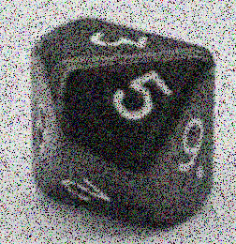
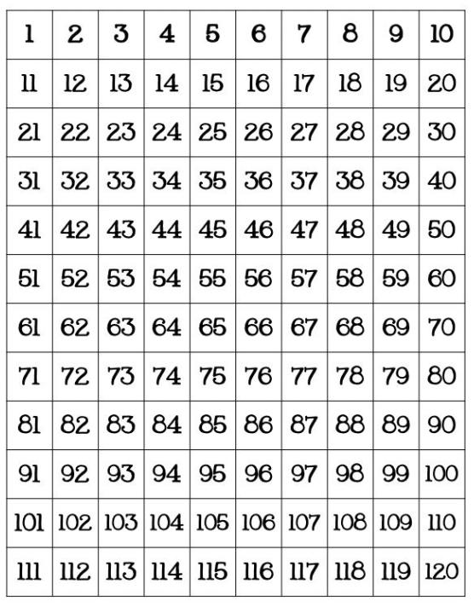
Skip-Counting Bingo
Materials:
120-chart,
10-sided dice
coloured counters
Students choose five Bingo numbers (above 10) in turn, and cover these with a coloured counter on a 120-chart.
Roll a 10-sided dice.
Together students keep skip-counting by whatever number is rolled (e.g., roll a 5, 10, 15, 20 etc).
Students stop skip-counting when they encounter a bingo number (or when they pass 120).
The dice is rolled again by a different player, and a new counting sequence is explored.
Play continues until one of the players removes all their numbers and shouts ‘Bingo!’.

Slide 5
Skip-Counting Bingo:
Variation
Materials:
120-chart,
10-sided dice
coloured counters
Students choose five Bingo numbers (above 10) in turn, and cover these with a coloured counter on a 120-chart.
Roll a 10-sided dice.
Together students keep skip-counting by whatever number is rolled (e.g., roll a 5, 10, 15, 20 etc).
Students stop skip-counting when they encounter a bingo number (or when they pass 120).
The dice is rolled again by a different player, and a new counting sequence is explored.
Play continues until one of the players removes all their numbers and shouts ‘Bingo!’.
Variation: If a 1 is rolled, the roller moves one of their counters to an unoccupied number and then rolls the dice again.

Slide 6
Skip-Counting Bingo:
Reflection
Variation: If a 1 is rolled, the roller moves one of their counters to an unoccupied number and then rolls the dice again.
What was this variation designed to help students to notice?

Slide 7
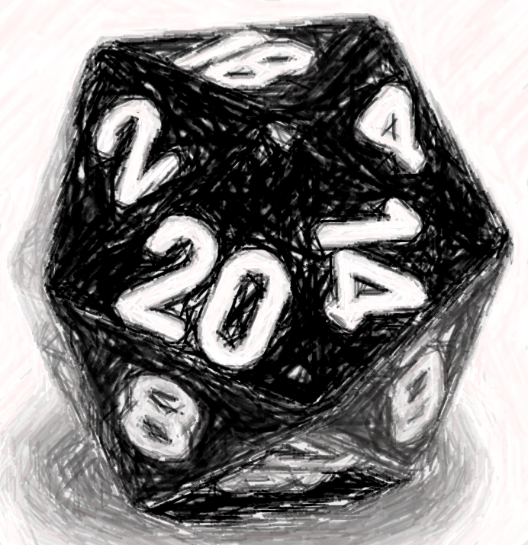
Skip-Counting Bingo
Differentiation
Materials:
120-chart,
20-sided dice
coloured counters
Students choose five Bingo numbers (above 20) in turn, and cover these with a coloured counter on a 120-chart.
Roll a 20-sided dice.
Together students keep skip-counting by whatever number is rolled (e.g., roll a 5, 10, 15, 20 etc).
Students stop skip-counting when they encounter a bingo number (or when they pass 120).
The dice is rolled again by a different player, and a new counting sequence is explored.
Play continues until one of the players removes all their numbers and shouts ‘Bingo!’.
Variation: If a 1 is rolled, the roller moves one of their counters to an unoccupied number and then rolls the dice again.

Slide 8
Skip-Counting Bingo:
An investigation
What do you think are the three best numbers to choose in the 20-sided dice version?
How are they the same or different than the best numbers in the 10-sided dice version?

Slide 9
Skip-Counting Bingo:
Reflection
Differentiation: A 20- sided dice
How did changing the dice (and the minimum number) change the level of challenge in the game?

Slide 10
Doubles Bingo: Variation
Materials:
120-chart,
20-sided dice
coloured counters
Students choose five Bingo numbers (above 20) in turn, and cover these with a coloured counter on a 120-chart.
Roll a 20-sided dice.
Together students keep doubling by whatever number is rolled (e.g., roll a 5, 10, 20, 40 etc).
Students stop doubling when they encounter a bingo number (or when they pass 120).
The dice is rolled again by a different player, and a new doubling sequence is explored.
Play continues until one of the players removes all their numbers and shouts ‘Bingo!’.
Variation: If a 1 is rolled, the roller moves one of their counters to an unoccupied number and then rolls the dice again.

Slide 11
Doubles Bingo: Investigation
What do you think are the three best numbers to choose in the doubling version?
How are they the same or different than the best numbers in the skip-counting version?

Slide 12
Doubles Bingo:
Reflection
Variation: A Doubling
What was this variation designed to help students notice?

Slide 13
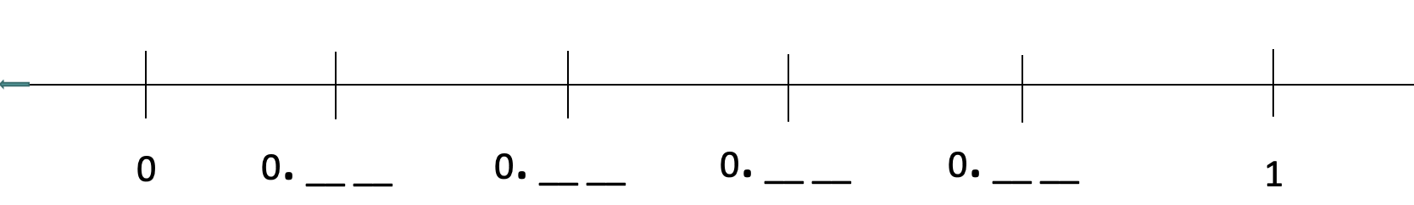
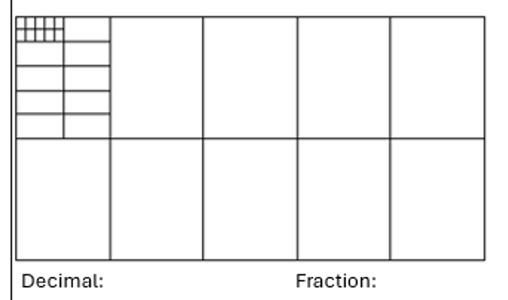
Deci Dice
Materials:
10-sided dice,
number line template,
decimats
Create an appropriately challenging gameboard (i.e., number line template).
A communal dice is rolled.
Players decide where to place the digit rolled on their number line, and lock in their choice by recording this number in the blank slot.
The communal dice is rolled again, and the process is repeated. The game continues until there are no blanks remaining on the number line.
Players who finish with a gameboard where all their numbers are correctly ordered on the number line win a point.
Players who can ‘prove’ their number line works (or doesn’t work) on a decimat get a bonus point.

Slide 14
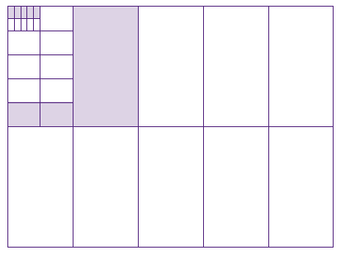
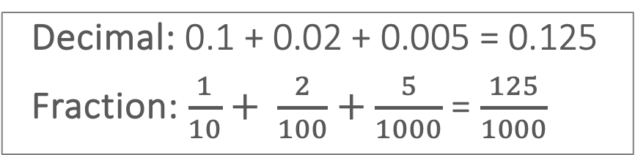
Deci Dice:
‘Proving it’ with a Decimat
Decimal: 0.1 + 0.02 + 0.005 = 0.125
Fraction: $\frac{1}{10}+ \frac{2}{100}+\frac{5}{1000}$ = $\frac{125}{1000}$

Slide 15
Deci Dice
0. __ __
0. __ __
0. __ __
0. __ __
0
1

Slide 16
Deci Dice:
Variation
0. __ __
0. __ __
0. __ __ __
0. __
0
1

Slide 17
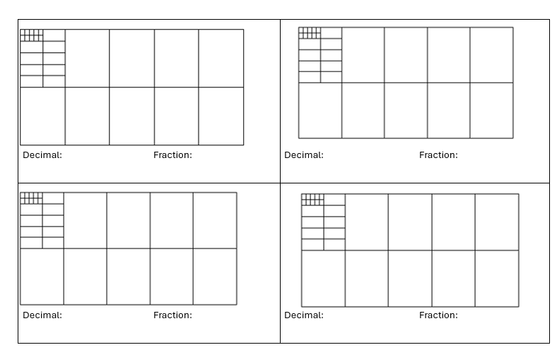

Slide 18
Deci Dice:
Investigation
How might you re-arrange the digits rolled in our last round of Deci Dice to make your number line as accurate (i.e., ‘to scale’) as possible?

Slide 19
Deci Dice:
Reflection
Variation: Introduction of ragged decimals
What was this variation designed to help students to notice?

Slide 20
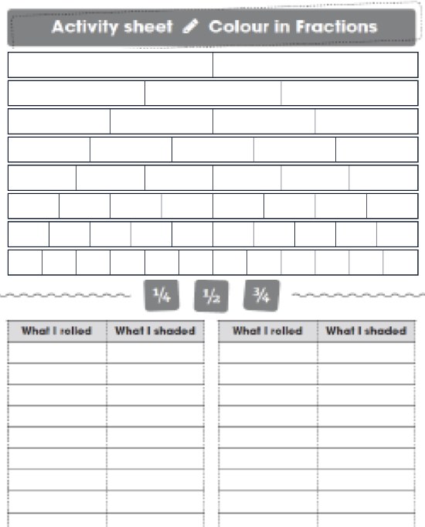
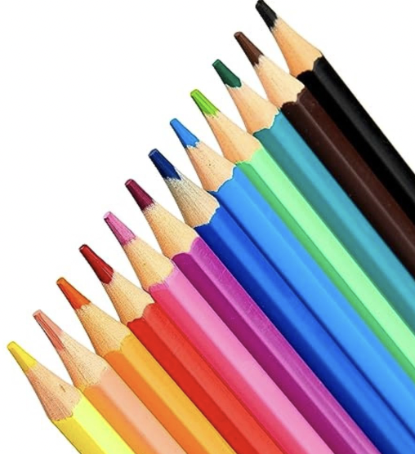
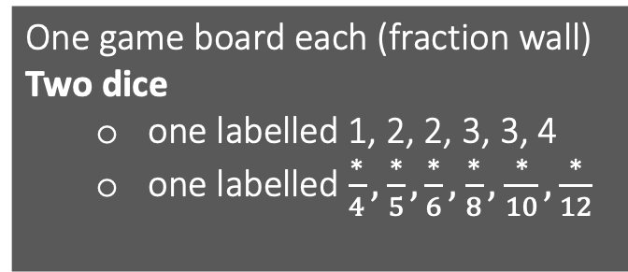
Colour in Fractions
One game board each (fraction wall)
Two dice
  one labelled 1, 2, 2, 3, 3, 4
  one labelled $\frac{∗}{4},$ $\frac{∗}{5}, \frac{∗}{6},$ $\frac{∗}{8},$ $\frac{∗}{10}, \frac{∗}{12}$
3 players in a group
Players in turn throw both dice.
They make a fraction, the first dice being the numerator.
They then colour the equivalent of the fraction shown.
If a player is unable to use their turn, they “pass”.
Winner is the first person to colour in their whole wall
Note: Each row is worth 1 (so the value of the entire fraction wall is 6)
Note: Players can create improper fractions

Slide 21
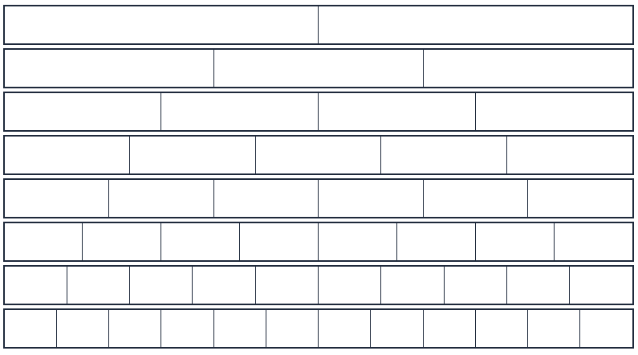
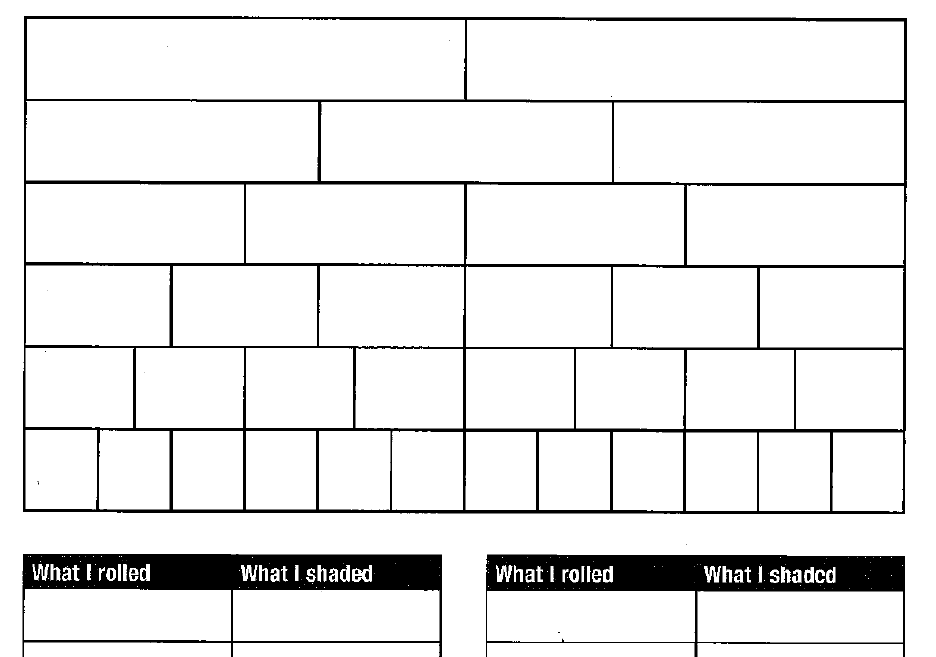
Fraction Wall

Slide 22


Slide 23

Colour in Fractions:
Variation
One game board each (fraction wall)
Two dice
  one labelled 1, 2, 2, 3, 3, 4
  one labelled $\frac{∗}{2},$ $\frac{∗}{3}, \frac{∗}{6},$ $\frac{∗}{8},$ $\frac{∗}{10}, \frac{∗}{12}$
3 players in a group
Players in turn throw both dice.
They make a fraction, the first dice being the numerator.
They then colour the equivalent of the fraction shown.
If a player is unable to use their turn, they “pass”.
Winner is the first person to colour in their whole wall
Note: Each row is worth 1 (so the value of the entire fraction wall is 6)
Note: Players can create improper fractions

Slide 24
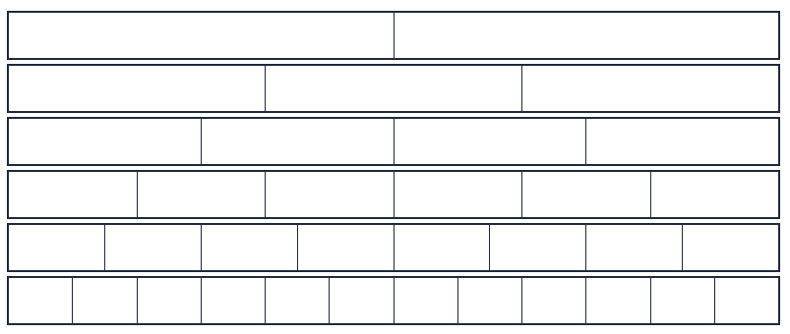
Fraction Wall

Slide 26
Colour in Fractions:
Reflection
Variation: Changed denominator dice and simplified fraction wall (no fifths, no tenths).
What was this variation designed to help students to notice?

Slide 27
Reflecting on the workshop
How might you apply the ideas discussed today around differentiation and variation to how you use mathematical games in your own context?

Slide 28
Educationally-rich mathematical games: Workshop
James Russo
james.russo@monash.edu
www.surfmaths.com/games

