Slide 1


COMPUTATIONAL
THINKING THROUGH PLAY
Chris Wetherell
Director – Program Design & Publications
Australian Maths Trust
CMA Conference – March 2026

Slide 2
The rules
Number of players: 2 or 3
Materials: pen/pencil and blank paper

Slide 3
The rules
Start with a (small) number of crosses on the page

Slide 4
The rules
Players take turns linking one endpoint to another
Each new line gets a cross somewhere in the middle

Slide 5
The rules
New lines cannot cross old lines
✗

Slide 6
The rules
New lines cannot cross old lines
✗

Slide 7
The rules
New lines cannot cross old lines
Whoever makes the last move is the winner!

Slide 8
Your task
Play the game several times
Vary the number of crosses
at the start of the game
Who wins?
Is there a strategy?
Does the strategy depend on the number of crosses?
Does the strategy depend on who starts?
Does the strategy depend on the number of players?

Slide 9
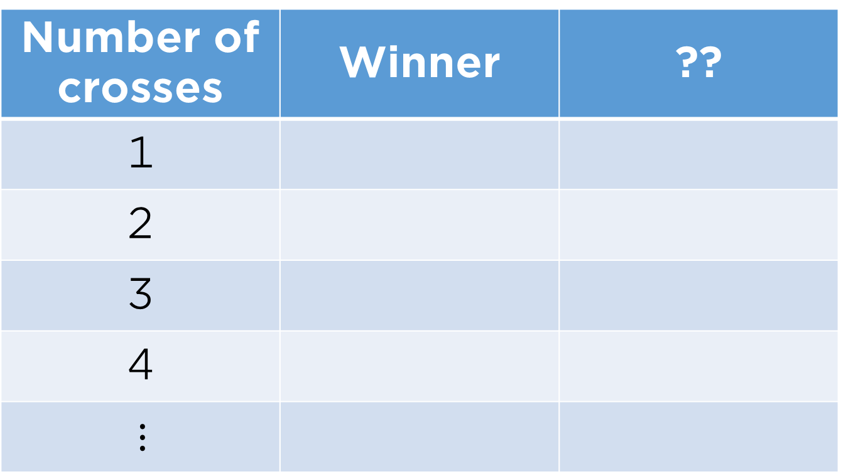
Results (2-player game)
Number of crosses | Winner | ??
1
2
3
4

Slide 10
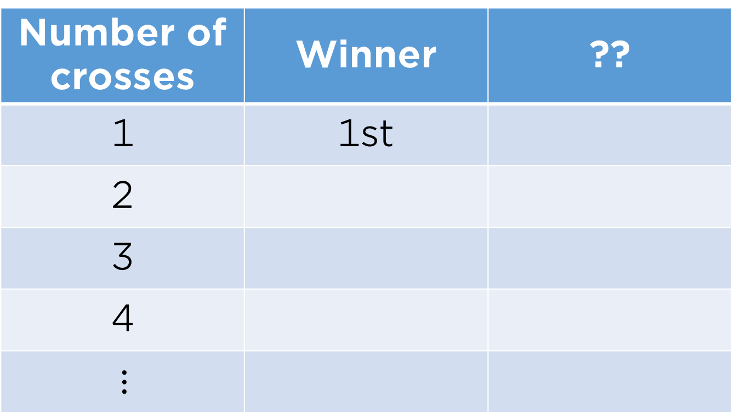
Results (2-player game)
Number of crosses | Winner | ??
1 | 1st
2
3
4

Slide 11
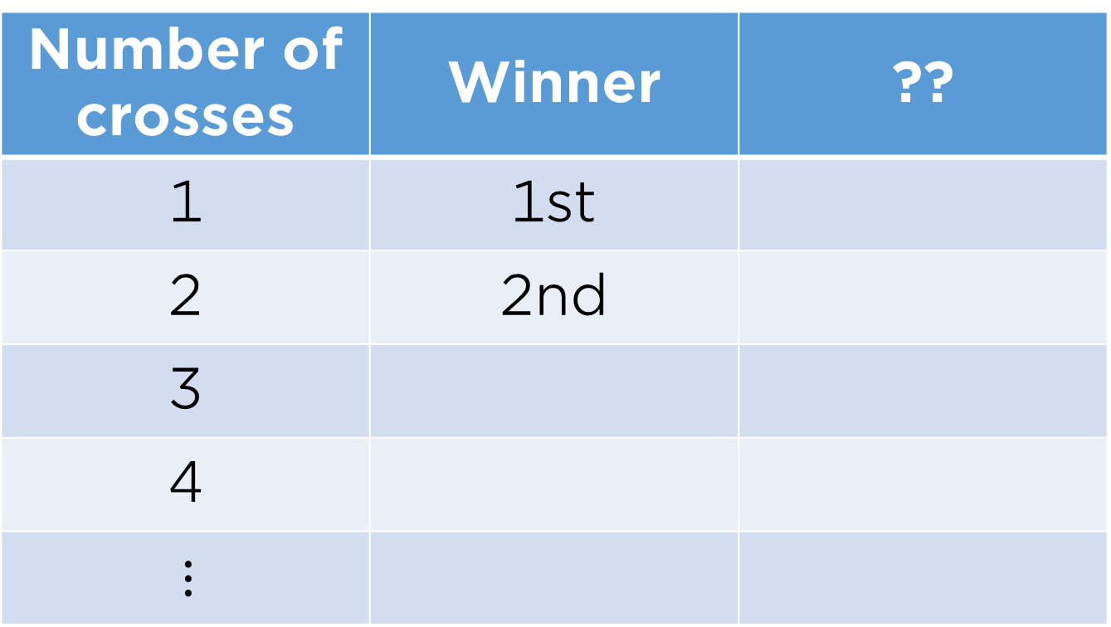
Results (2-player game)
Number of crosses | Winner | ??
1 | 1st
2 | 2nd
3
4

Slide 12

Results (2-player game)
Number of crosses | Winner | ??
1 | 1st
2 | 2nd
3 | 1st
4

Slide 13
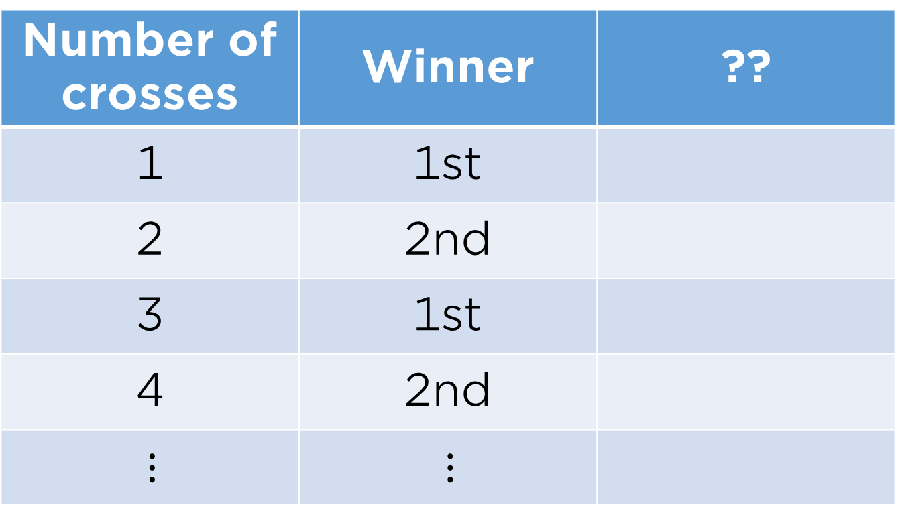
Results (2-player game)
Number of crosses | Winner | ??
1 | 1st
2 | 2nd
3 | 1st
4 | 2nd

Slide 14
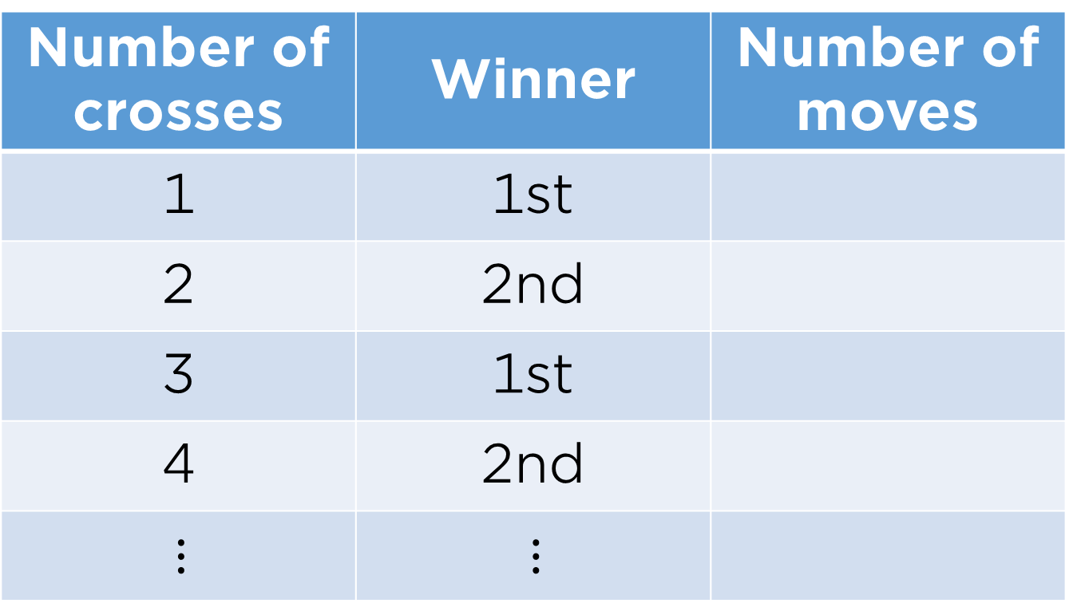
Results (2-player game)
Number of crosses | Winner | Number of moves
1 | 1st
2 | 2nd
3 | 1st
4 | 2nd

Slide 15
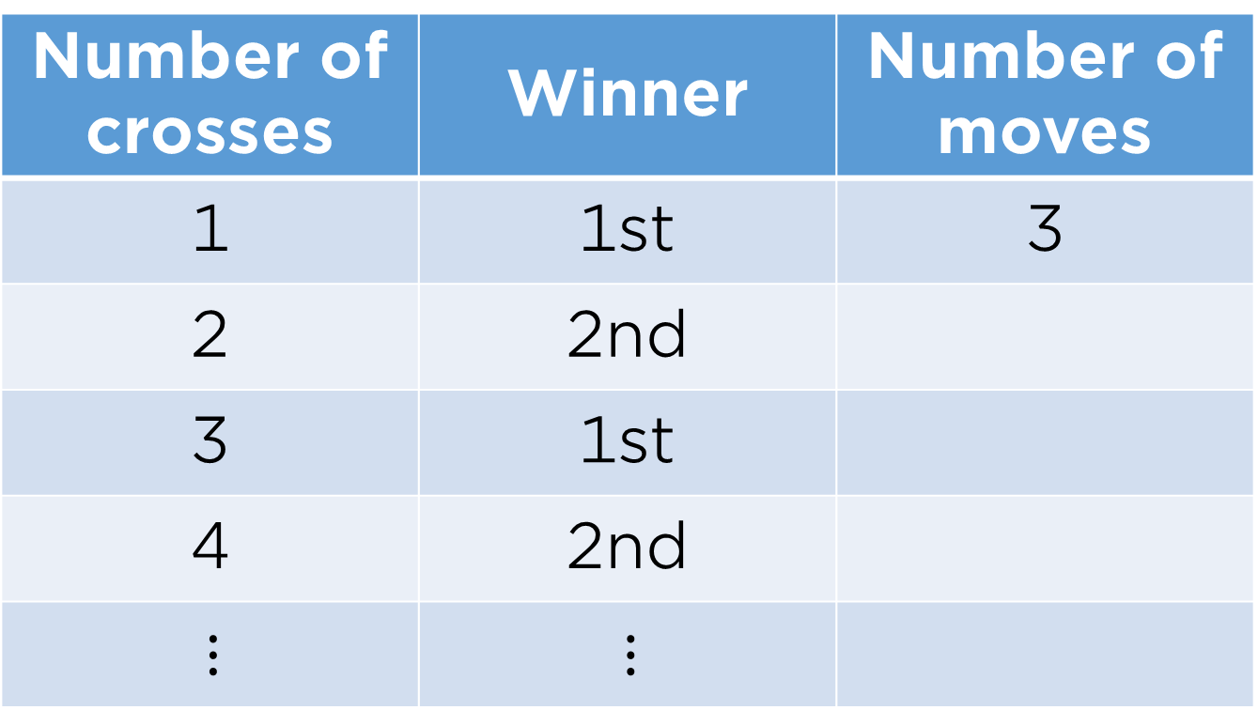
Results (2-player game)
Number of crosses | Winner | Number of moves
1 | 1st | 3
2 | 2nd
3 | 1st
4 | 2nd

Slide 16
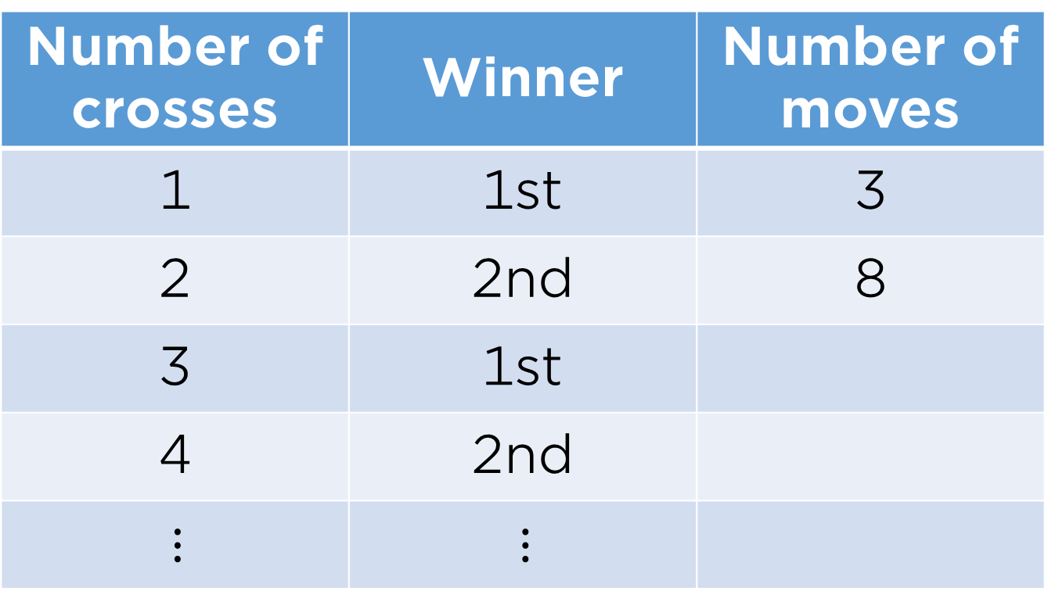
Results (2-player game)
Number of crosses | Winner | Number of moves
1 | 1st | 3
2 | 2nd | 8
3 | 1st
4 | 2nd

Slide 17
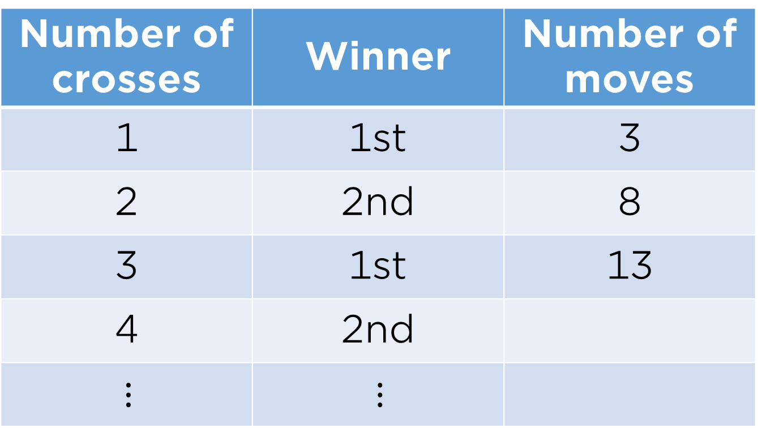
Results (2-player game)
Number of crosses | Winner | Number of moves
1 | 1st | 3
2 | 2nd | 8
3 | 1st | 13
4 | 2nd

Slide 18
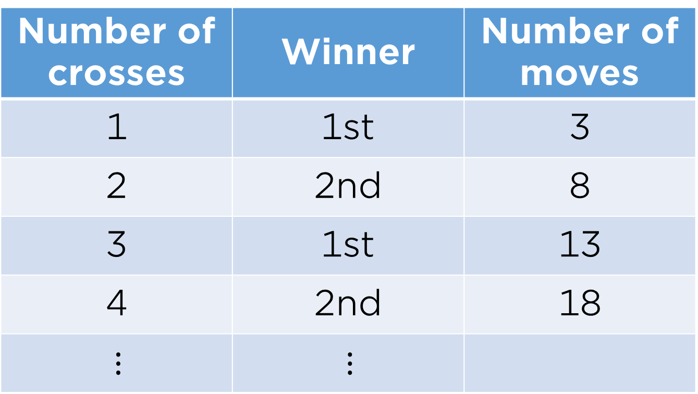
Results (2-player game)
Number of crosses | Winner | Number of moves
1 | 1st | 3
2 | 2nd | 8
3 | 1st | 13
4 | 2nd | 18

Slide 19

Results (2-player game)
Number of crosses | Winner | Number of moves
1 | 1st | 3
2 | 2nd | 8
3 | 1st | 13
4 | 2nd | 18
Does the pattern continue?

Slide 20
Planar graph (no crossing edges)

Slide 21
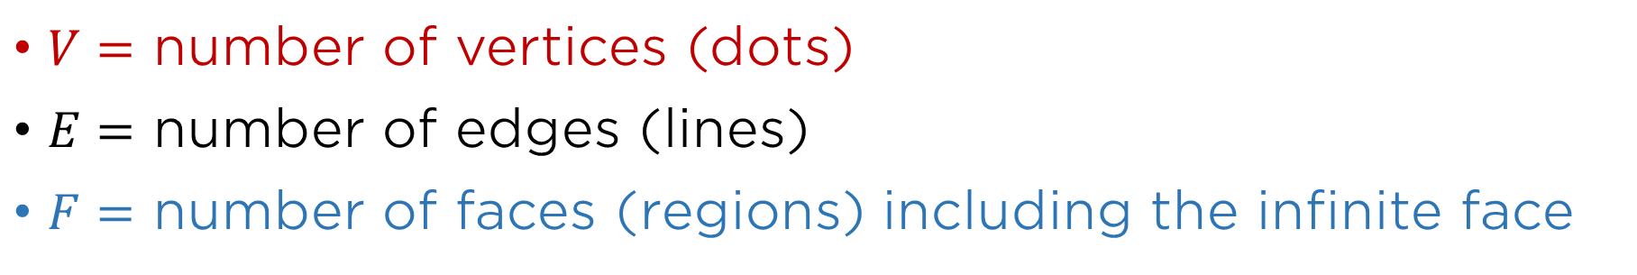
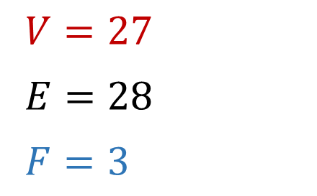

Planar graph (no crossing edges)

Slide 22
Euler’s formula

Slide 23
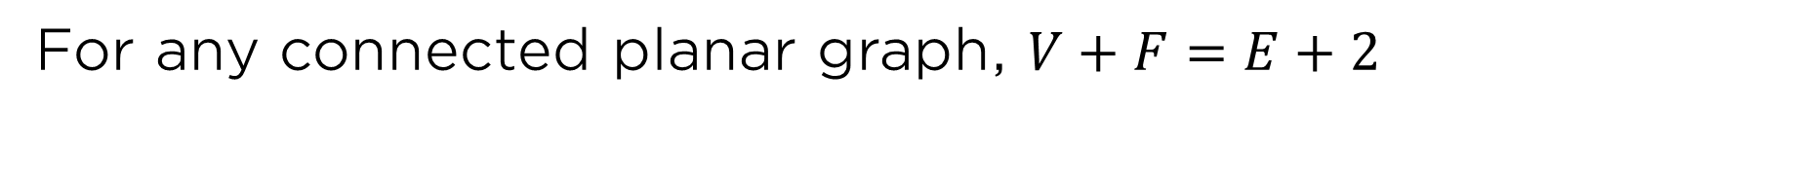




Euler’s formula

Slide 24


























Euler’s formula

Slide 25
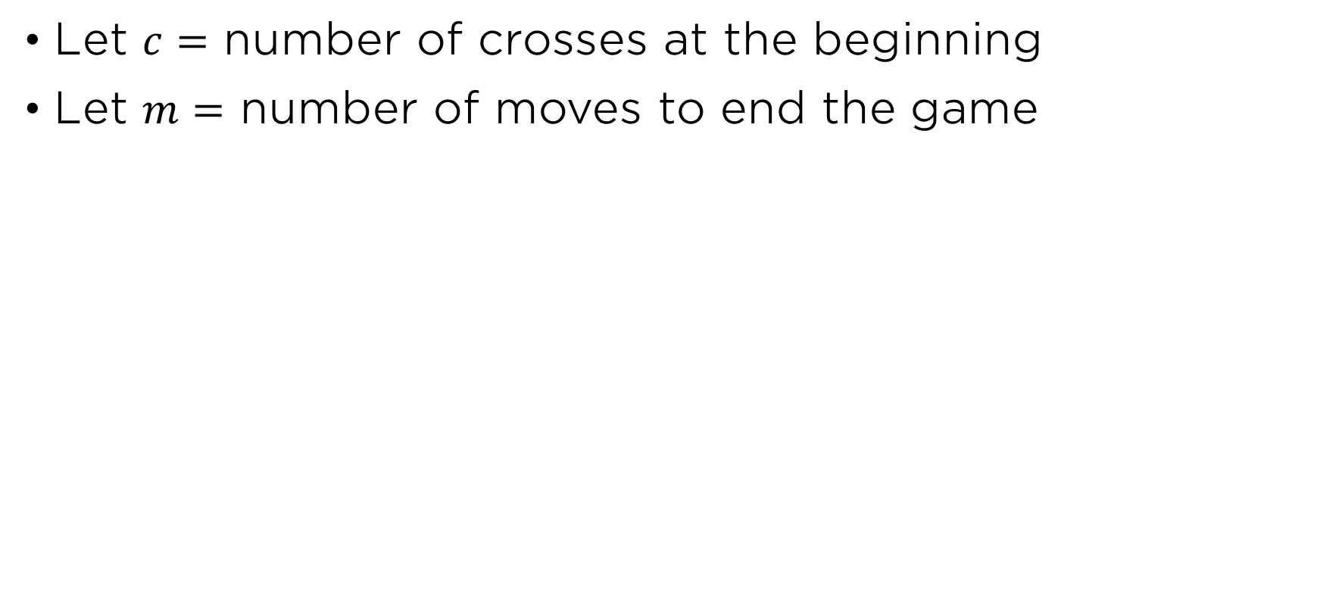










Formula for number of moves

Slide 26
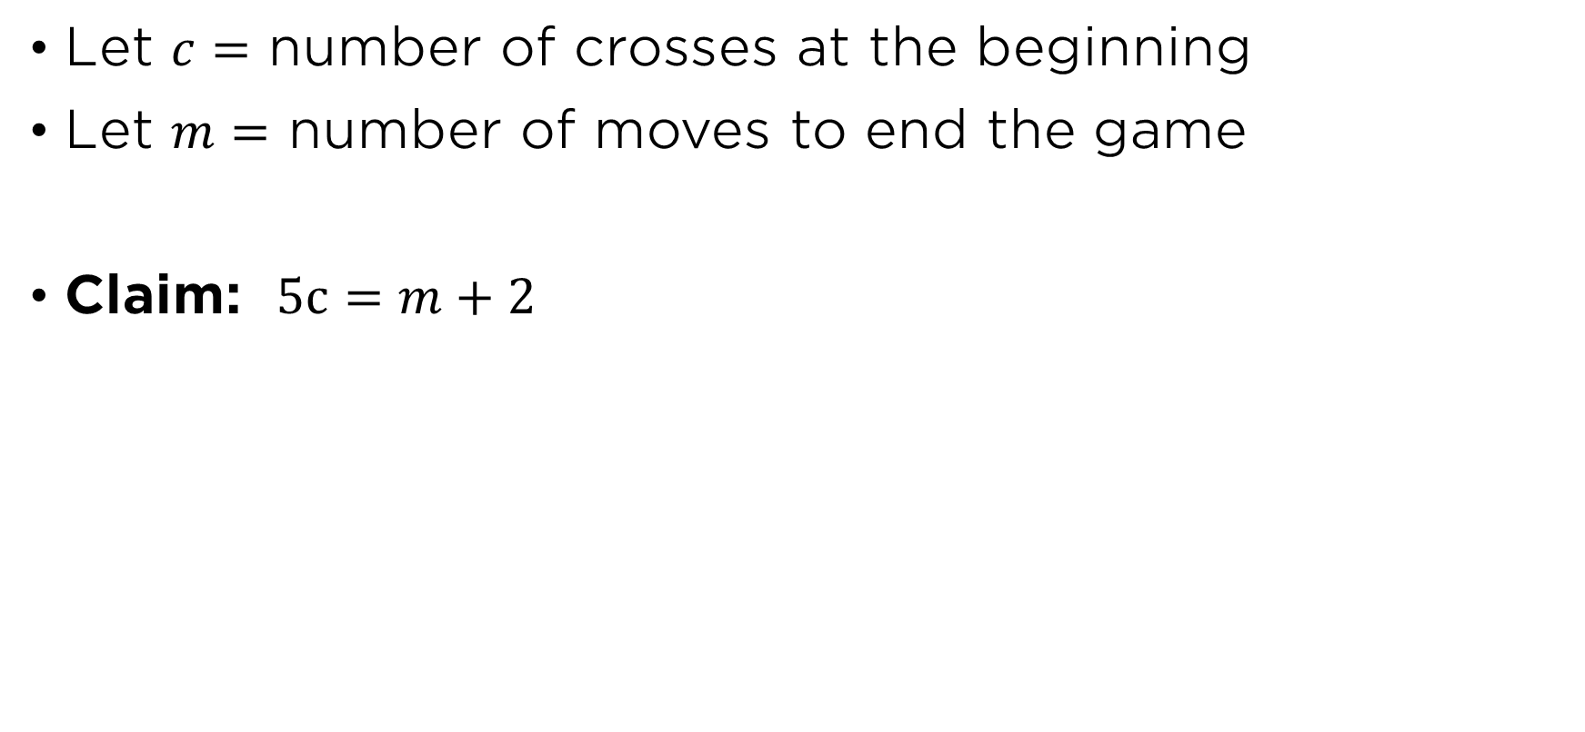





Formula for number of moves

Slide 27
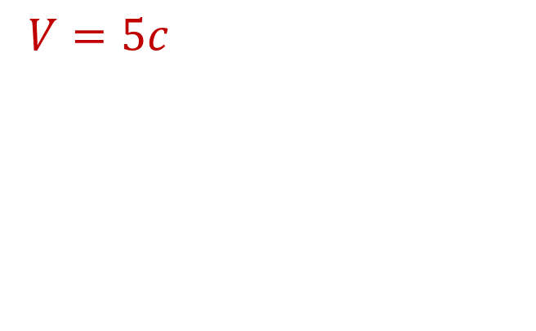
Formula for number of moves

Slide 28
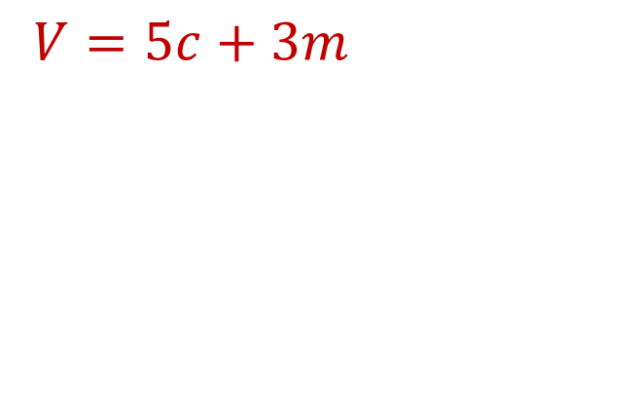
Formula for number of moves

Slide 29
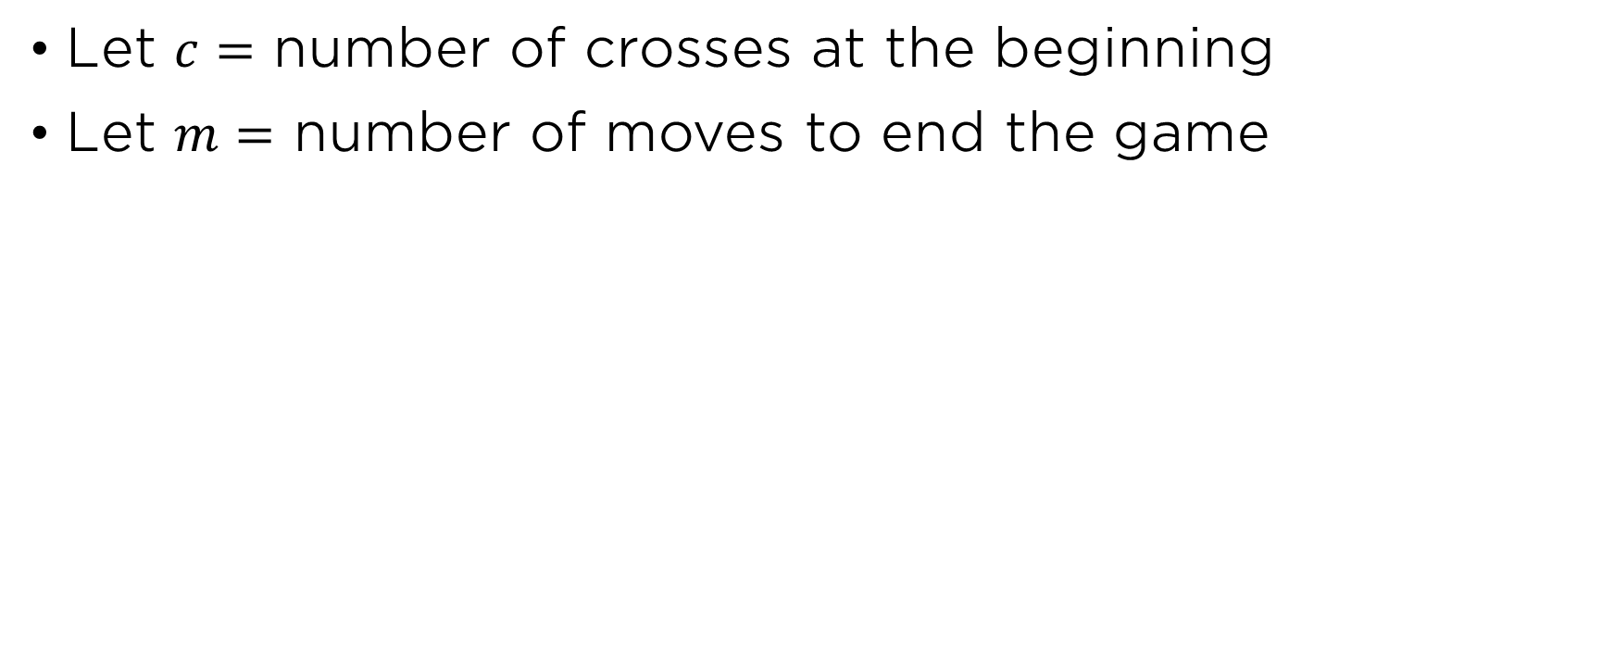
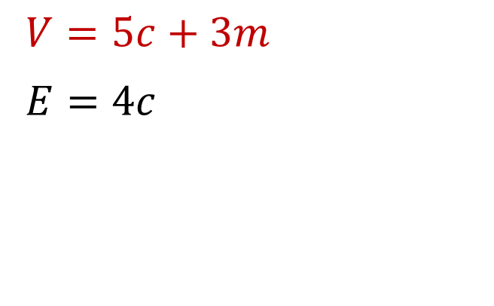
Formula for number of moves

Slide 30
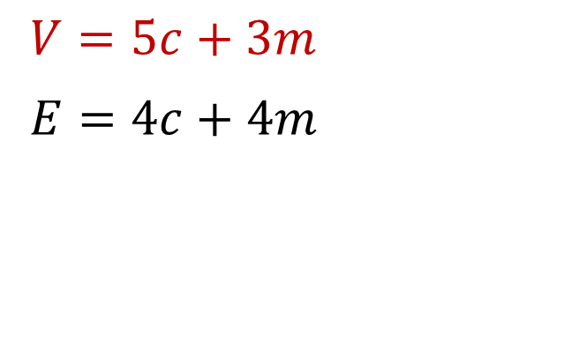
Formula for number of moves

Slide 31
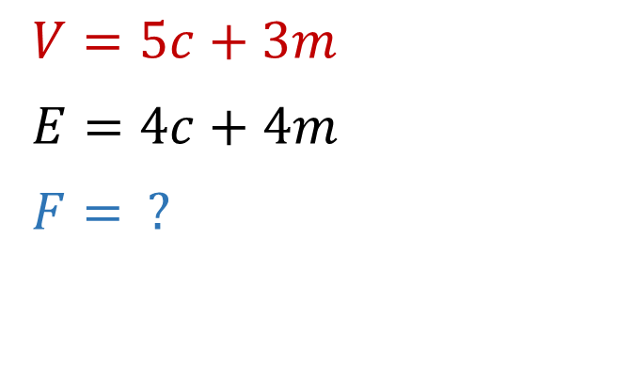
Formula for number of moves

Slide 32
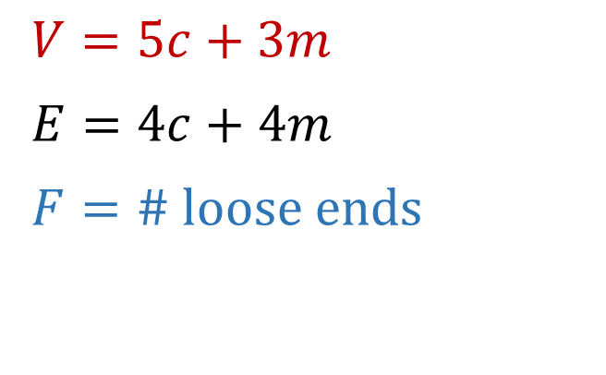
Formula for number of moves

Slide 33
Formula for number of moves

Slide 34
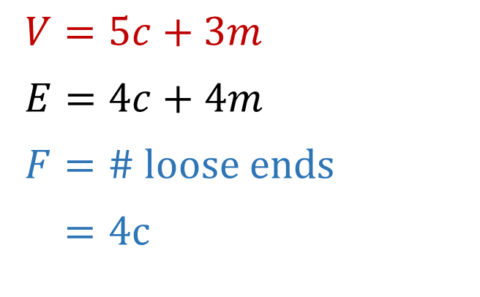
Formula for number of moves

Slide 35
Formula for number of moves

Slide 36
Formula for number of moves

Slide 37
Formula for number of moves

Slide 38
Formula for number of moves

Slide 39
Formula for number of moves

Slide 40
Formula for number of moves

Slide 41
Formula for number of moves

Slide 42

Formula for number of moves

Slide 43

Formula for number of moves

Slide 44
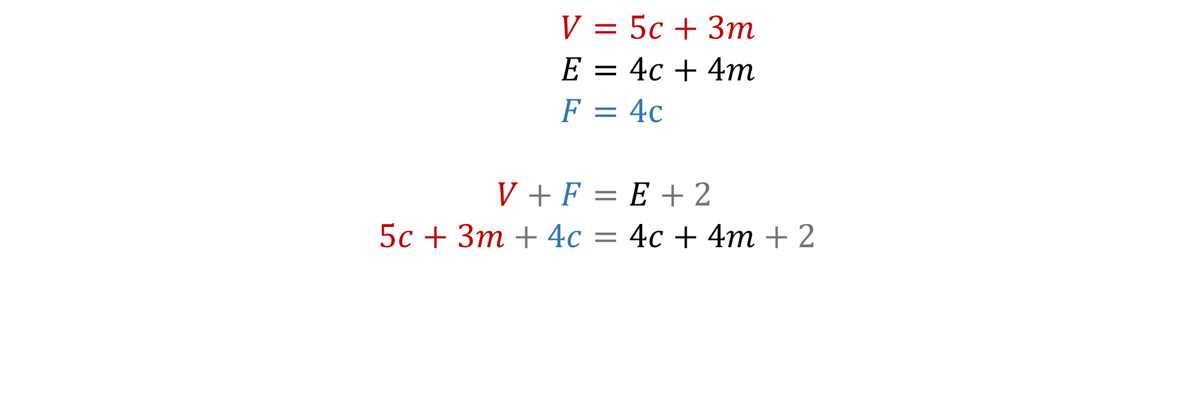
Formula for number of moves

Slide 45
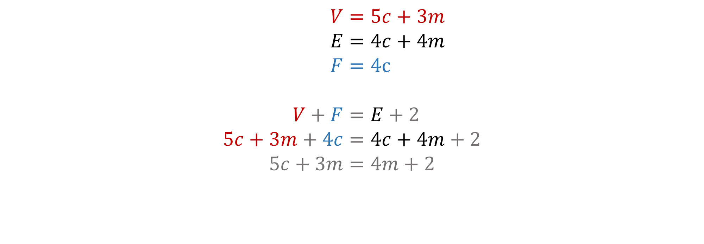
Formula for number of moves

Slide 46
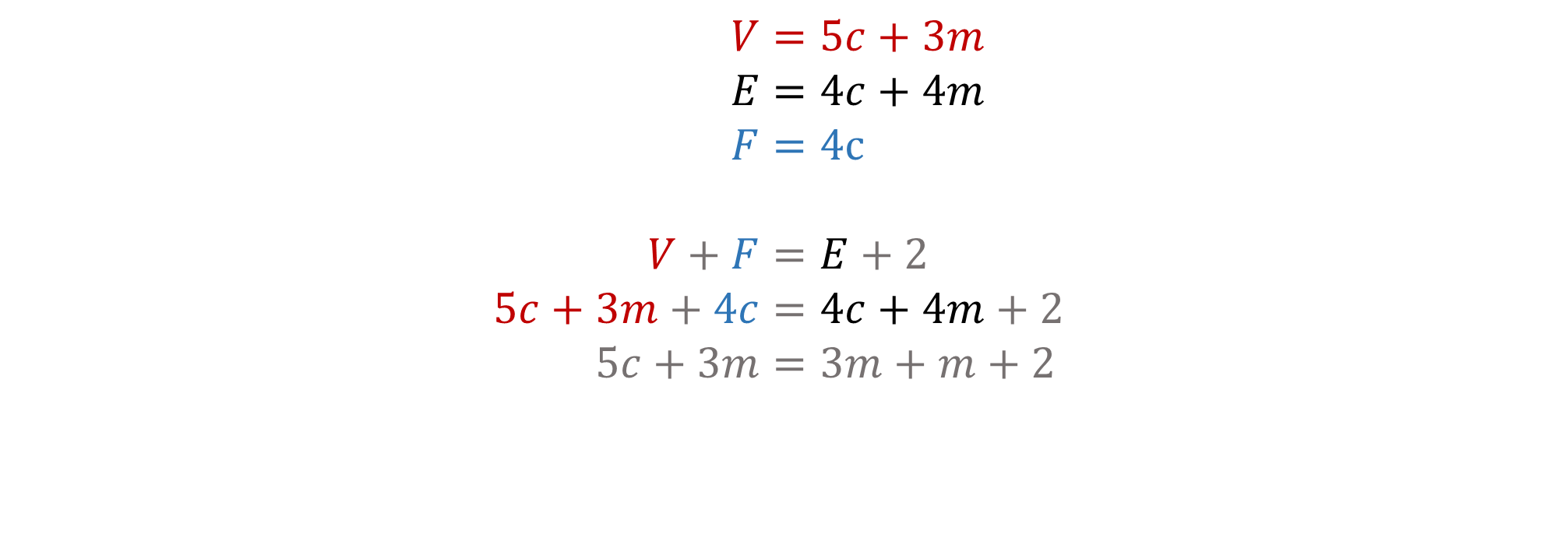
Formula for number of moves

Slide 47
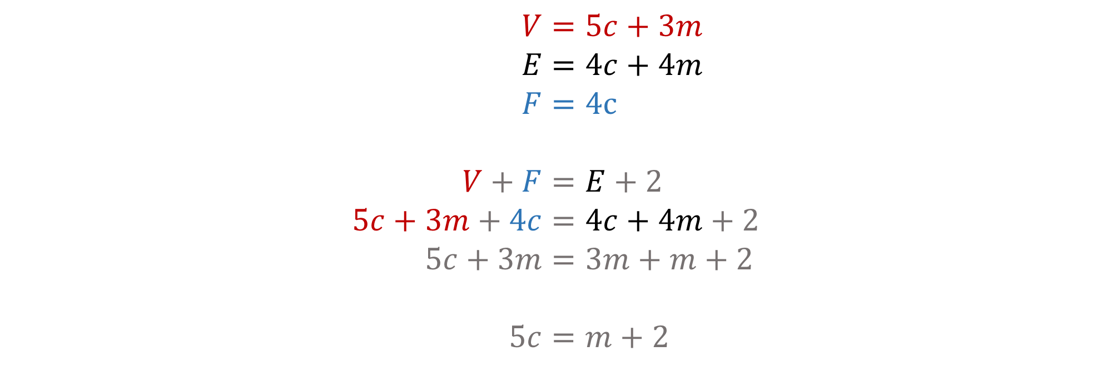
Formula for number of moves

Slide 48
AMT programs involving networks
Bebras Computational Thinking Challenge
February each year, Years 3 to 12
Computational and Algorithmic Thinking (CAT)
May each year, Years 5 to 12
Maths Enrichment
April–October each year
Olympiad program
  Newton – Year 5/6
  Euler – Year 7/8
  Noether – Year 9/10
  Pólya – Year 10
amt.edu.au … see your conference flier for more details!

