Slide 1

Educationally-rich mathematical games
James Russo
james.russo@monash.edu
www.surfmaths.com/games

Slide 2

The King’s Tax
Adaptation of Greedy Pig. Instead of using dice, it uses cards.
This means the probabilities change constantly, based on what cards have been turned over.
Begin by shuffling the deck. One card is turned over (e.g., 7).
This is the amount of money each player has ‘earned’ (e.g., $7).
After each card is revealed, players must decide if they are staying in or ‘banking’ their money. Once you bank, you can’t return for that round.
Those who stay in add the value of the next card (e.g., 4) to their earnings for the round (e.g., $7+$4 = $11). They must again choose to stay in or ‘bank’.
If a KING is turned over, he collects his tax. Players who are still in get nothing for that round.
If a QUEEN is turned over, players who are still in DOUBLE their score for the current round.
If a JACK is turned over, players get a $15 bonus.
JOKER is wild – decide its value at the beginning of each game.
🌟 Most money banked after all Kings are revealed wins with game 🌟

Slide 3

The King’s Tax:
An investigation
Andrea ended her round on $50.
The following cards had been played:
3, Queen, 7, 10, 5, Joker.
What order might the cards have been played in?
What are some different possibilities for the value of the joker?

Slide 4
The King’s Tax:
An investigation
Andrea ended her round on $50.
The following cards had been played:
3, Queen, 7, 10, 5, Joker.
What order might the cards have been played in?
What are some different possibilities for the value of the joker?
3, Q, 7, 10, 5, J
Joker = $22
7, 3, 10, 5, Q, J
Joker = $0
7, 3, 5 J, Q, 10
Joker = $5

Slide 5
How frequently do you play maths games in your mathematics classroom?
All the time (e.g., 4-5 times per week)
Often (e.g., 2-3 times per week)
Sometimes (e.g., once per week)
Rarely (e.g., once per month)
Never

Slide 6
How frequently do primary teachers play maths games in their mathematics classroom?
All the time (e.g., 4-5 times per week) 32%
Often (e.g., 2-3 times per week) 47%
Sometimes (e.g., once per week) 19%
Rarely (e.g., once per month) 2%
Never 0%

Slide 7
What are the characteristics of highly valued maths games?
Theme | % | Example games
Dice and/ or playing cards | 60% | Greedy Pig; Dice Cricket
Pen and Paper Only | 17% | Mastermind; Bingo
Oral Games | 11% | Buzz; 21.
Custom Cards (Sourced/ Created by teacher) | 4% | I am, who is?
Commercial Games | 2% | Prime Climb
‘Real World’ | 2% | Chocolate, Music
Digital Games | 1% | Wishball
Counters | 1% | Bullseye

Slide 8
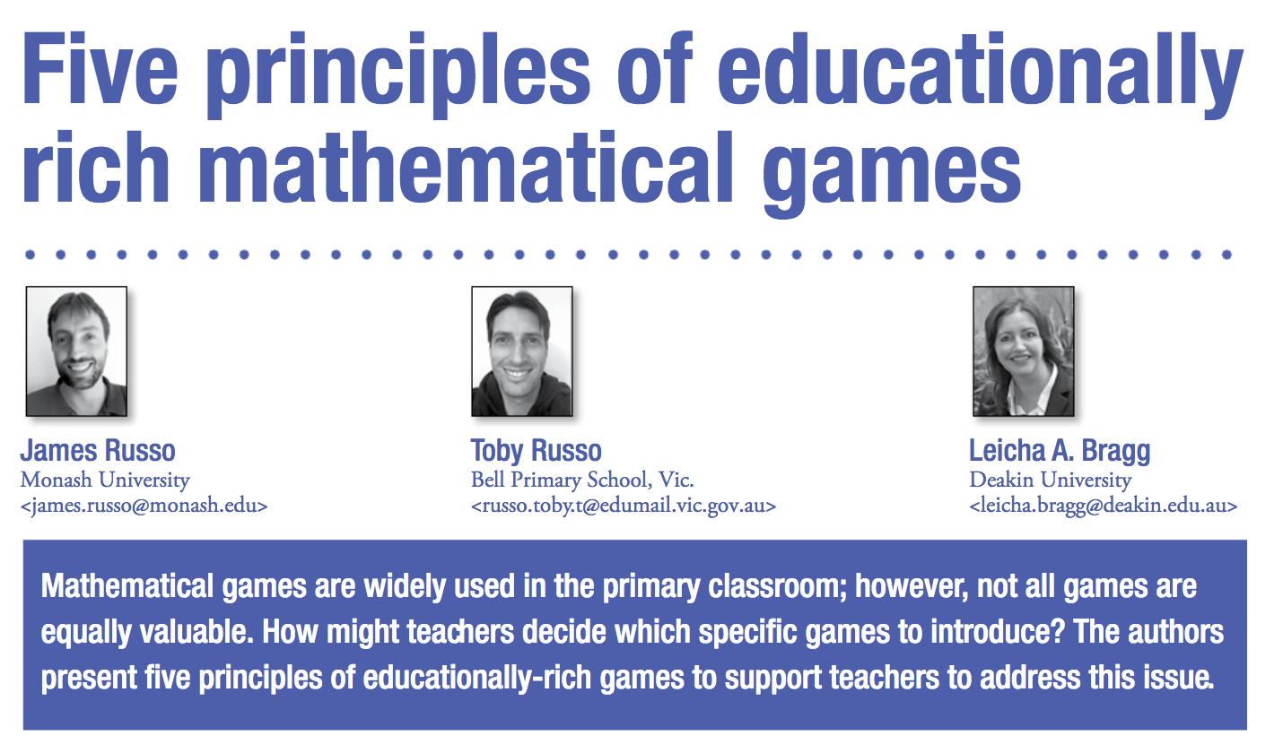
What makes a ‘good’ mathematical game?

Slide 9
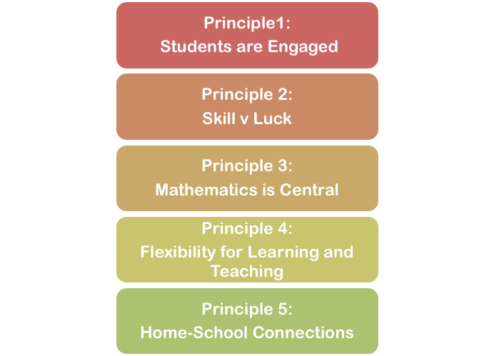
Five principles of educationally-rich mathematical games

Slide 10
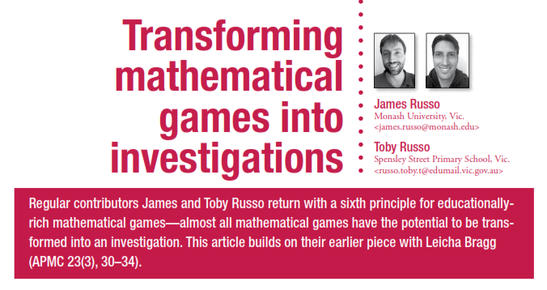

Slide 11
Principle 1.
Students are Engaged
Games should be engaging, enjoyable and generate mathematical discussion.
Games generate more on-task behaviour and dialogue than non-game based activities (Bragg 2012a), but not necessarily more learning (Bragg 2012b).
Games students are not motivated to play are unlikely to generate positive learning outcomes compared with alternative activities.

Slide 12
Principle 1.
Students are Engaged
What is it about The King’s Tax that makes it engaging?
  Competitive
  Fast paced
  Physical movement
  Simple mechanics
  Whole class can play with a personal stake
What are some maths games that you think are highly engaging for students to play?

Slide 13

Principle 1.
Students are Engaged
What is it about The King’s Tax that makes it engaging?
  Competitive
  Fast paced
  Physical movement
  Simple mechanics
  Whole class can play with a personal stake
What are some maths games that you think are highly engaging for students to play?

Slide 14
Principle 2.
Skill and Luck are balanced
Without luck, more mathematically proficient students will dominate.
Without skill/ choice, agency is non existent and intrinsic motivation is limited.
Balance between luck and skill engages students (Numberger-Haag et al, 2023).
Balance can have positive social impact; i.e. all students need to learn to be a ‘good loser’ or ‘gracious winner’.

Slide 15
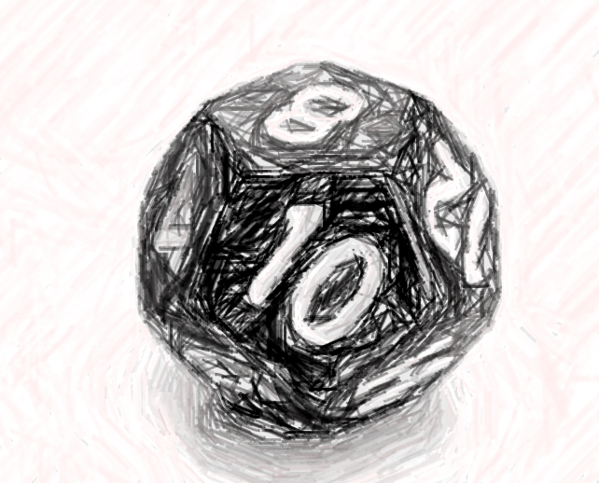

Caught red-handed (Version 1.0) (patterns and strategy)
Instructions:
Roll the dice (e.g., 5).
Write the sequence of numbers up to (and including) the number rolled (1, 2, 3, 4, 5).
A game of rock-paper-scissors decides who begins the game.
On their turn, each player is allowed to cross out (in order) 1 or 2 numbers.
Goal: To cross out the last number.
Materials:
marker and 12-sided dice
Working group: 2 players

Slide 16
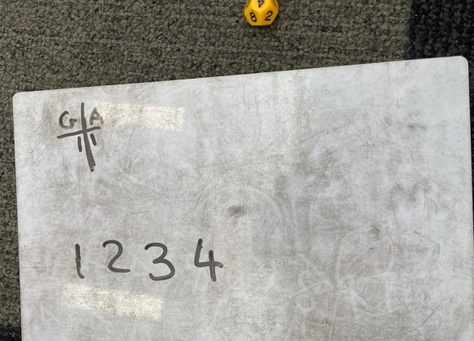
Caught red-handed (Version 1.0)
This is an example of a game from a Year 1 classroom.
Gabby is beginning the game.
What should she do?

Slide 17
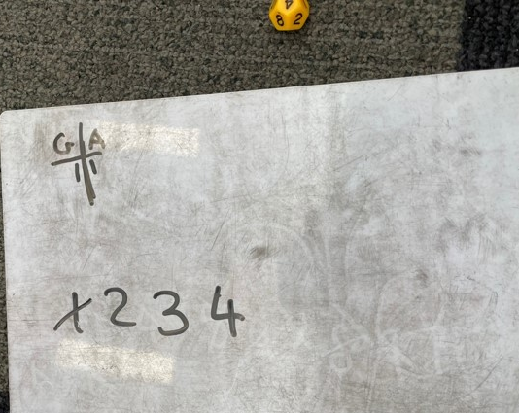
Caught red-handed (Version 1.0)
This is an example of a game from a Year 1 classroom.
Gabby is beginning the game.
What should she do?

Slide 18
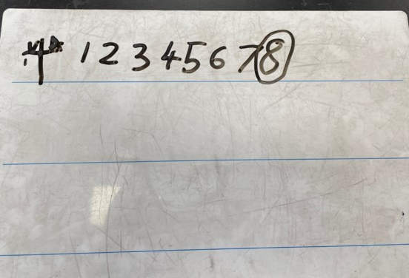
Caught red-handed (V 1.0):
An Investigation
Vanessa won rock-paper-scissors and has a decision to make.
Should she be first or second player, and what should her first move be?
What advice would you have for Vanessa?

Slide 19


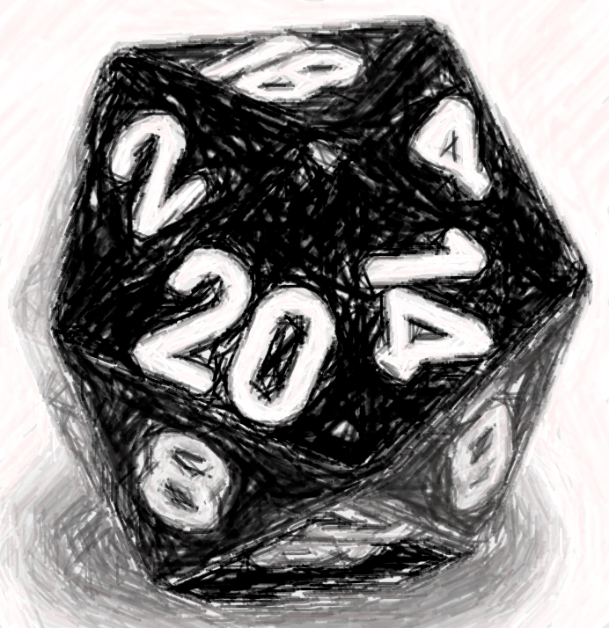
Caught red-handed (Version 2.0) (patterns and strategy)
Instructions:
Circle the number 20 and roll a 20-sided dice to determine the two other ‘red’ numbers to circle.
A game of rock-paper-scissors decides who begins the game.
On their turn, each player is allowed to cross out (in order) 1 or 2 numbers.
Goal: To finish having crossed out the most red numbers
OR
The first to cross out 11 numbers across multiple games.
Materials:
Red pen, black pen,
20-sided dice
Working group: 2 players

Slide 20
Principle 2.
Skill and Luck are balanced
Luck
Skill
Snakes and Ladders
The King’s Tax
Caught Red- Handed
Chess

Slide 21
Principle 2.
Skill and Luck are balanced
Luck
Skill
Snakes and Ladders
The King’s Tax
Caught Red- Handed
Chess
Reflect on your list of engaging maths games.
Where do you think they might belong on the Luck – Skill continuum?

Slide 22
Principle 2.
Skill and Luck are balanced
We can modify games to improve the balance between luck and skill.
What might be some modifications we can make to Snakes and Ladders to introduce some skill into the game?

Slide 23
Principle 2.
Skill and Luck are balanced
We can modify games to improve the balance between luck and skill.
What might be some modifications we can make to Snakes and Ladders to introduce some skill into the game?
  Introduce a second counter. Players choose which one to move.
  Players can move forwards or backwards on their turn.
  Roll three dice. Discard one. Sum the other two dice together and move that many places.

Slide 24
Principle 3.
Mathematics is Central
Games are used purposefully; chosen game matches specific learning objective.
Games could be focused on:
  Skill practice (e.g. addition facts; skip-counting)
  Deepening understanding of important concepts (e.g., place value; number patterns)
  Exposure to new concepts (e.g. conditional probability)
  Strategic thinking / problem solving (e.g. nim games)
Many games provide the opportunity to develop all four proficiencies.

Slide 25
Principle 3.
Mathematics is Central
‘Gold Standard’ Games:
Mathematically Integrated Games
Principle 1: Strategic Agency Aligned with Mathematics (most important)
Principle 2: Embedded Mathematical Representations
Principle 3: Space for Reflection and Recording

Slide 26
Principle 3.
Mathematics is Central
Principle 1:
Strategic Agency Aligned with Mathematics
Key idea: Student choice must matter mathematically.
In Mathematically Integrated Games, the choices players make are central to the mathematics, not peripheral.
Success in the game depends on reasoning with core mathematical ideas, not just luck or recall.
Consider: Where in this game do students make decisions that directly engage them with mathematical concepts?

Slide 27
Principle 3.
Mathematics is Central
Principle 2:
Embedded Mathematical Representations
Key idea: The game space itself acts as a mathematical model.
The board or playing structure is not decorative; it is the representation (e.g., arrays, fraction walls, number lines).
Students reason within and through these representations as they play.
Consider: How does the gameboard/structure represent the mathematical ideas you want students to explore?

Slide 28
Principle 3.
Mathematics is Central
Principle 3:
Space for Reflection and Recording
Key idea: Build in opportunities to make thinking visible.
Recording links action, representation, and symbolic expression.
Structured reflection surfaces strategies and deepens understanding.
Consider: What opportunities are built into the game for students to record, discuss, or justify their mathematical thinking?

Slide 29

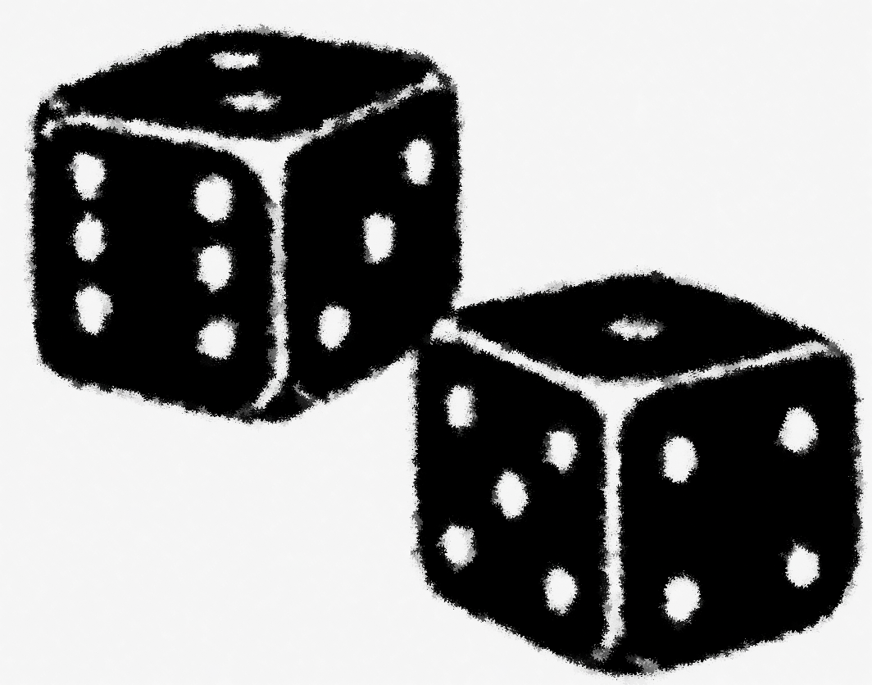
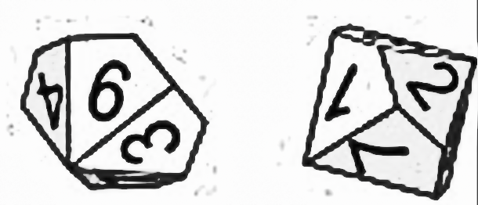
Land Grab
(aka Multiplication Paddocks)
Gameboard:
Grid paper.
Dice:
2 x 6-sided
OR
2 x 10-sided
OR
20 sided and 6-sided
Roll the Game Dice. These represent the factors (e.g., 13 and 6).
Consider whether the multiplication fact would fit on the grid paper (13 × 6), or whether you might need to separate it into two facts using the distributive property (e.g., 10 × 6 and 3 × 6)
Draw the corresponding rectangle(s) of your multiplication fact in your colour, and record the fact.
Play continues until all space on the grid paper is gone (or until players agree that further play is not productive)
Whichever player has grabbed the most land (i.e., controls the most squares) is the winner.
OR
OR

Slide 30
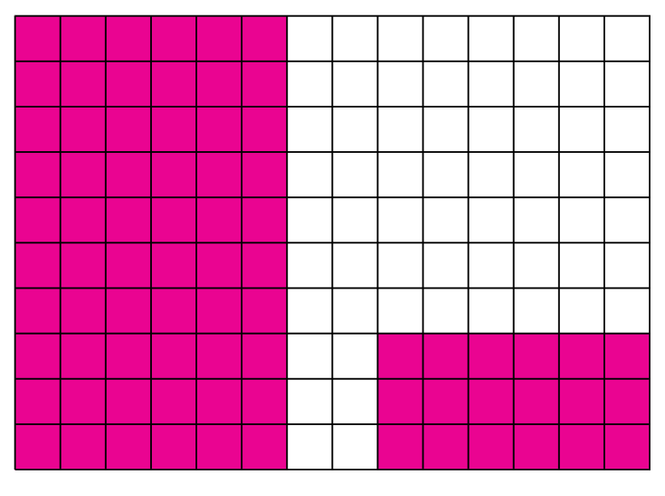
Player 1 rolls a 13 and a 6
Shaded:
10 × 6 = 60
3 × 6 = 18
Total:
13 × 6 = 78

Slide 31
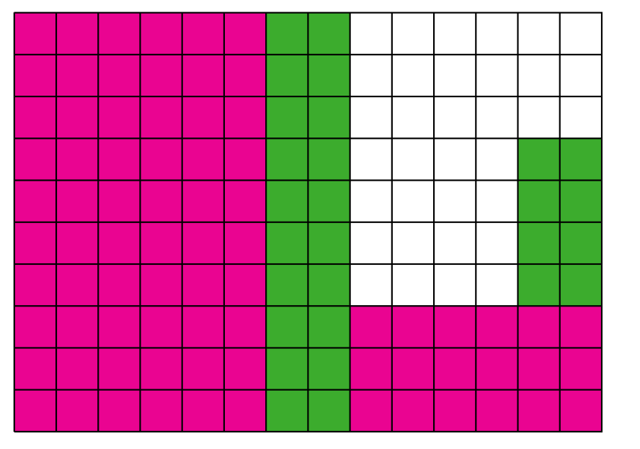
Player 2 rolls a 14 and a 2
Shaded:
10 × 2 = 20
4 × 2 = 8
Total:
14 × 2 = 28

Slide 32
Principle 3.
Mathematics is Central
How is mathematics central to Landgrab?
1. Strategic agency aligned with mathematical content
Students make meaningful decisions about how to use their dice rolls—for example, whether to place a 4 × 6 or 6 × 4 array to maximise space or block an opponent.
  Later in the game, they may break up an array (e.g., 13 × 5 into 10 × 5 + 3 × 5) to fit remaining space—engaging directly with the distributive property.
  These strategic decisions are mathematical, not just tactical.

Slide 33
Principle 3.
Mathematics is Central
How is mathematics central to Landgrab?
2. Embedded mathematical representation
The grid functions as a visual and spatial model of area and multiplication.
Each move creates an array, reinforcing area as an array model and supporting structural reasoning about factors and products.
The gameboard is the representation—it drives and reveals

Slide 34
Principle 3.
Mathematics is Central
How is mathematics central to Landgrab?
3. Space for reflection and recording
Students record each move using number sentences (e.g., “I rolled 4 and 6: 4 × 6 = 24”), which links their strategic action to formal notation.
This supports reasoning about multiplication, reinforces the structure of arrays, and provides a basis for discussion and reflection on strategy and efficiency.

Slide 35
Closest to X
How to play:
Roll a 10 sided dice six times.
On each roll, decide where to play your number.
Once you decide you can’t change it.
🌟 Closest to the nominated target number wins 🌟

Slide 36
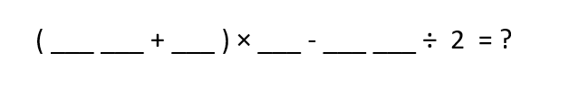
Closest to 100 (gameboard 1)
How to play:
Roll a 10 sided dice six times.
On each roll, decide where to play your number.
Once you decide you can’t change it.
🌟 Closest to the nominated target number wins 🌟

Slide 37
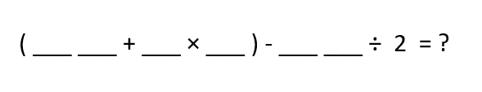
Closest to 100 (gameboard 2)
How to play:
Roll a 10 sided dice six times.
On each roll, decide where to play your number.
Once you decide you can’t change it.
🌟 Closest to the nominated target number wins 🌟

Slide 38

Closest to 100 (gameboard 3)
How to play:
Roll a 10 sided dice six times.
On each roll, decide where to play your number.
Once you decide you can’t change it.
🌟 Closest to the nominated target number wins 🌟

Slide 39
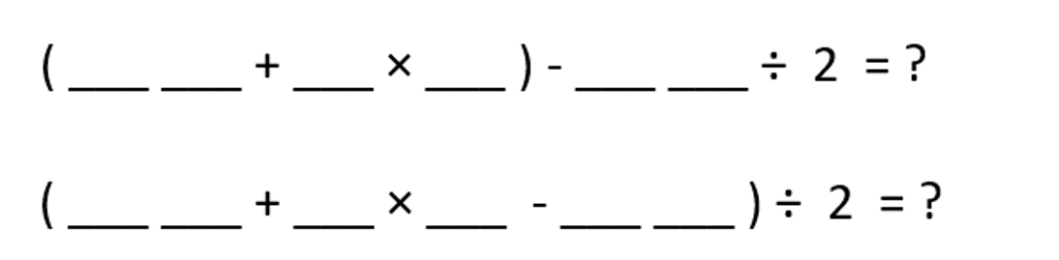
Closest to 100
An investigation
ChatGPT thought that Board 2 and Board 3 always give the same answer.
Do you agree?
Compare your totals for Board 2 and Board 3 across your rounds.
Look closely at the structure of each board.
Decide whether you think the two boards are actually the same or different.
Explain your thinking.

Slide 40
Closest to 100
An investigation… extended
1. Can you find any number combinations that make Board 2 and Board 3 give the same total? (So ChatGPT can be “correct” at least once!)
2. Create two new gameboards that look different but always give the same answer.

Slide 41
Principle 3.
Mathematics is Central
How is mathematics central to Closest to X?
Strategic agency aligned with mathematical content
Embedded mathematical representation
Space for reflection and recording

Slide 42
Principle 4.
Flexibility for learning and teaching: Differentiation
Games can support differentiated mathematics instruction.
Games should cater to varied ability levels:
  Through game dynamics (e.g. count-on vs bridging through 10)
  Through game mechanics, i.e. modifications (e.g. cards included in the deck)
  Through supporting materials (e.g. hundreds chart)

Slide 43
Principle 4.
Flexibility for learning and teaching: Differentiation
How might we modify “The King’s Tax” so it is suitable for younger students (e.g., Year 1 and 2)?
Reduce the deck so it only includes: 1, 2, 3, 4, 10, Queens, Kings
Use an interactive number chart to keep track of our class total

Slide 44
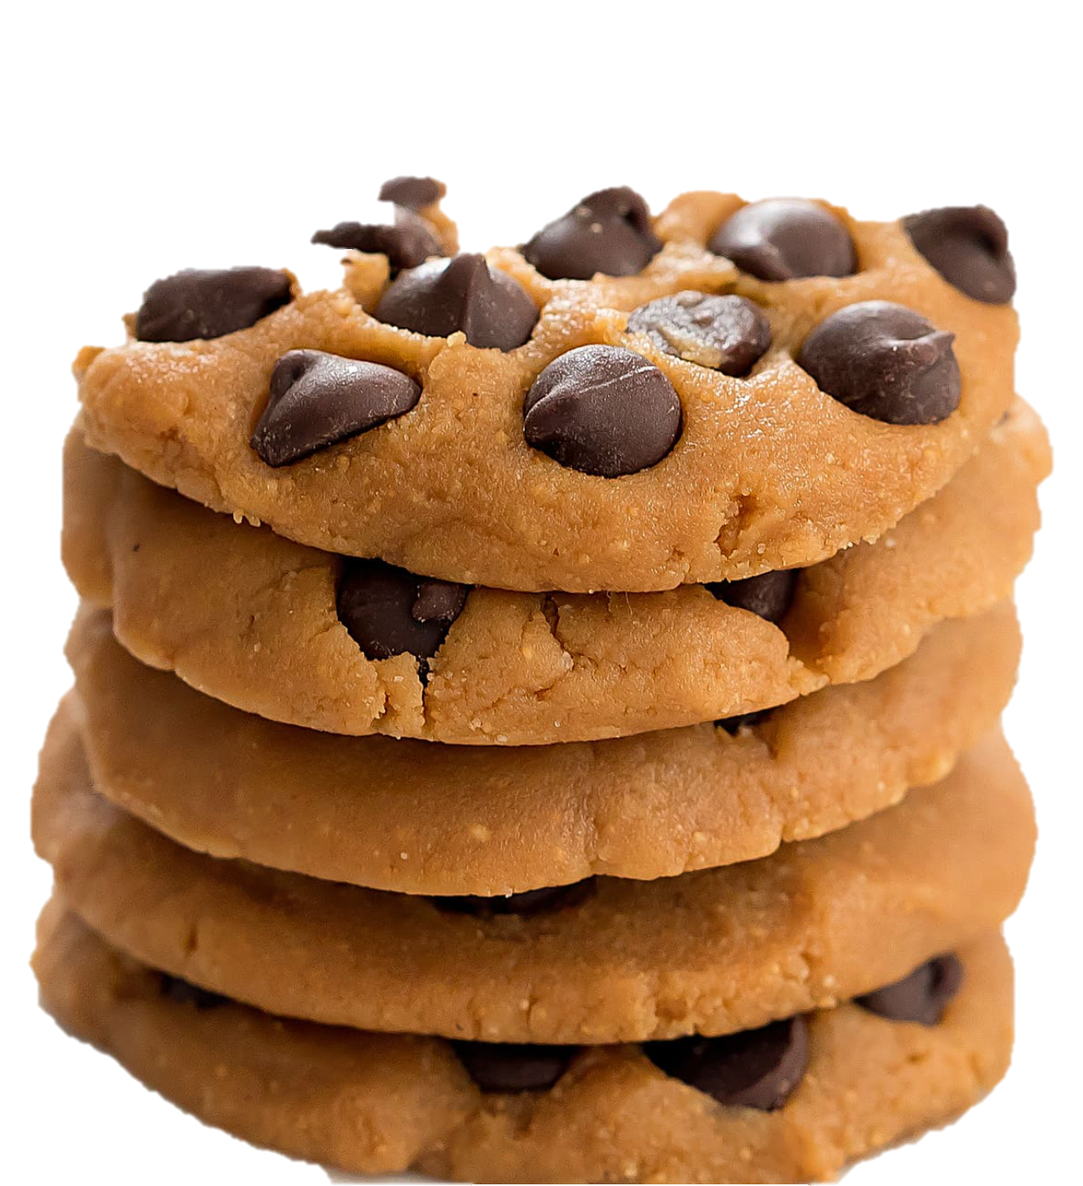
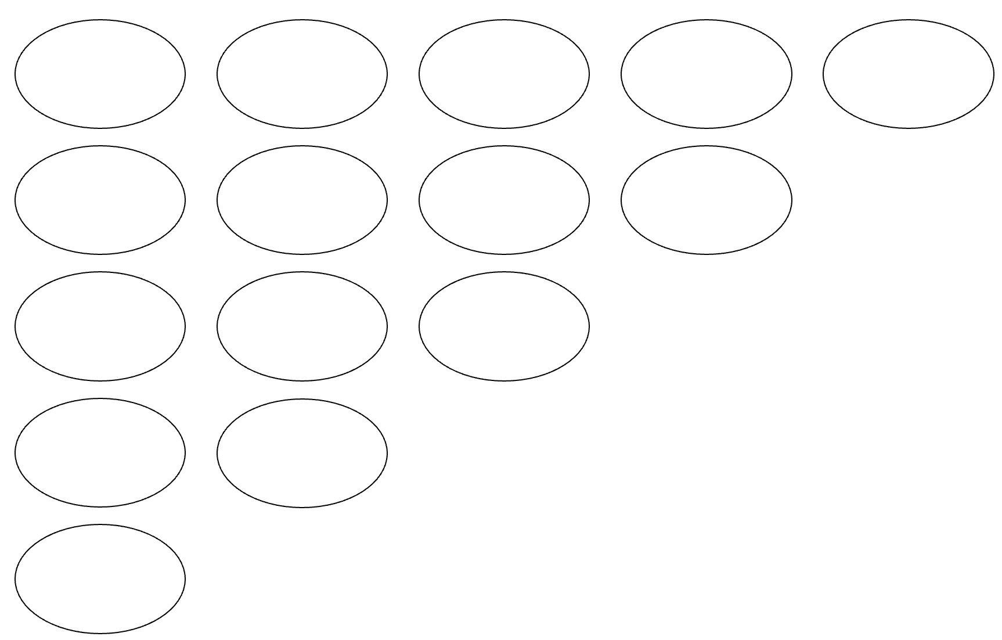
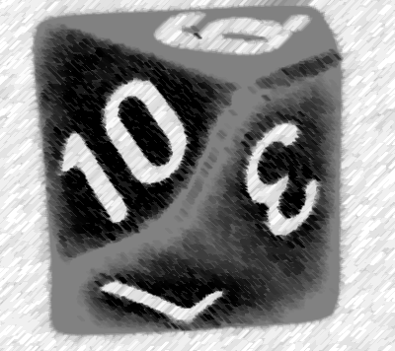
Choc-chip Cookies (multiplication)
Roll the Game Dice. Choose one of the rows.
The number rolled represents the number of choc-chips in each cookie for this particular row.
Try and arrange your ‘choc-chips’ on each cookie so they are in easy to subitise patterns.
Work out the total number of choc-chip cookies earned for your turn.
Begin the next rounds.
After 5 rounds your choc-chip cookie template will be full.
Whoever has recorded the most choc-chips is the winner!
Many structures
(individually, pairs/ small groups, beat the teacher).
Game-board: Choc-chip Cookie template (1 per player).
Game dice: 10-sided (1-10)

Slide 46
Principle 4.
Flexibility for learning and teaching: Differentiation
Choc-chip cookies can support differentiated mathematics instruction.
Through game dynamics (e.g. dots vs digits; counting-based strategies vs distributive property)
Through game mechanics, i.e., modifications (e.g. 6-sided dice vs 20-sided dice)
Through supporting materials (e.g. calculators to check your total)
:::.
:::.
:::.
7
7
7
5
2
5
2
5
2

Slide 47
Choc-chip Cookies (multiplication)
Roll the Game Dice. Choose one of the rows.
The number rolled represents the number of choc-chips in each cookie for this particular row.
Try and arrange your ‘choc-chips’ on each cookie so they are in easy to subitise patterns.
Work out the total number of choc-chip cookies earned for your turn.
Begin the next rounds.
After 5 rounds your choc-chip cookie template will be full.
Whoever has recorded the most choc-chips is the winner!
Many structures
(individually, pairs/ small groups, beat the teacher).
Game-board: Choc-chip Cookie template (1 per player).
Game dice: 10-sided (1-10)

Slide 48
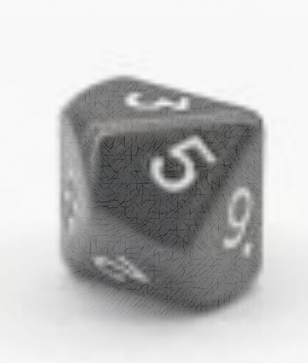
Choc-chip Cookies (multiplication)
Roll the Game Dice. Choose one of the rows.
The number rolled represents the number of choc-chips in each cookie for this particular row.
Try and arrange your ‘choc-chips’ on each cookie so they are in easy to subitise patterns.
Work out the total number of choc-chip cookies earned for your turn.
Begin the next rounds.
After 5 rounds your choc-chip cookie template will be full.
Whoever has recorded the most choc-chips is the winner!
Many structures
(individually, pairs/ small groups, beat the teacher).
Game-board: Choc-chip Cookie template (1 per player).
Game dice: 10-sided (0 -9)

Slide 50
Principle 4.
Flexibility for learning and teaching: Variation
Variation Theory (Kullberg et al. 2024).
Variation assists with deeper understanding of a concept. An idea or concept is “noticeable only if it varies against a background” that remains invariant.
Playing the same game again whilst purposefully changing a rule or substituting game materials can create a contrast and/or prompt a generalisation .

Slide 51
Principle 4.
Flexibility for learning and teaching: Variation
Contrast (example vs non-example)
  Critical aspect is varied; other aspects kept constant.
  Purpose: to notice differences.
Generalisation (many examples)
  Critical aspect is kept constant; other aspects are varied.
  Purpose: to notice sameness across situations.

Slide 52
Contrast vs Generalisation:
Choc-Chip Cookies
Critical aspect: Rolling a value of zero
Contrast (example vs non-example)
  “What happens when we roll a zero compared with when we roll another number (not zero)?”
  Asking this highlights contrast — noticing the difference in outcomes (zero choc-chips vs some choc-chips).
Generalisation (many examples)
  “If you rolled a zero and put it in the 4-cookie row, the 10-cookie row, or the 1-cookie row, what value do you get each time?”
  Asking this highlights generalisation — noticing the sameness across rows (groups of zero always total zero).

Slide 53
The King’s Tax
Adaptation of Greedy Pig. Instead of using dice, it uses cards.
This means the probabilities change constantly, based on what cards have been turned over.
Begin by shuffling the deck. One card is turned over (e.g., 7).
This is the amount of money each player has ‘earned’ (e.g., $7).
After each card is revealed, players must decide if they are staying in or ‘banking’ their money. Once you bank, you can’t return for that round.
Those who stay in add the value of the next card (e.g., 4) to their earnings for the round (e.g., $7+$4 = $11). They must again choose to stay in or ‘bank’.
If a KING is turned over, he collects his tax. Players who are still in get nothing for that round.
If a QUEEN is turned over, players who are still in DOUBLE their score for the current round.
If a JACK is turned over, players get a $15 bonus.
JOKER is wild – decide its value at the beginning of each game.
🌟 Most money banked after all Kings are revealed wins with game 🌟

Slide 54
The King’s Tax:
Poorer edition
Adaptation of Greedy Pig. Instead of using dice, it uses cards.
This means the probabilities change constantly, based on what cards have been turned over.
In this version of the game, black cards are positive (+) and red cards are negative (-).
For example, if a black seven is turned over, it is worth positive 7 (so it earns the player $7); if a red seven is turned over, it is worth negative 7 (so it costs the player $7).
If a KING is turned over, he collects his tax. Players who are still in get nothing for that round.
If a black QUEEN is turned over, players who are still in multiply their score by positive two (× + 2)
If a red QUEEN is turned over, players who are still in multiple their score by negative two (× - 2).
🌟 Most money banked after all Kings are revealed wins with game 🌟

Slide 55
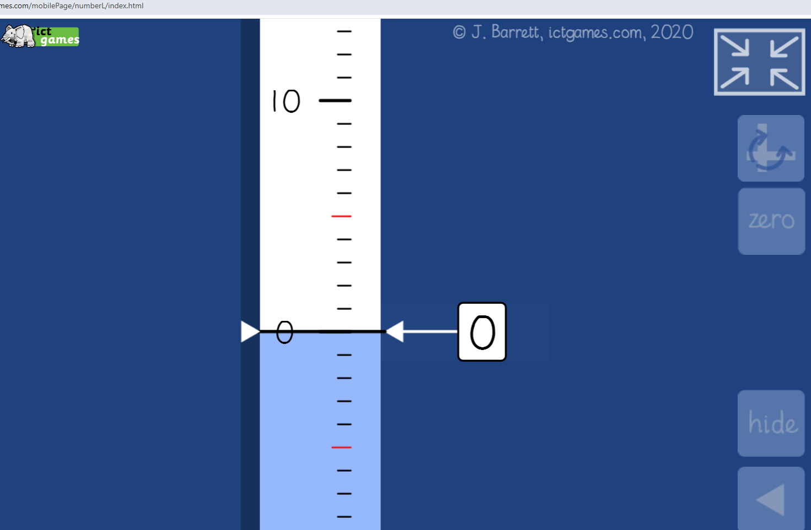

Slide 56
Principle 5.
Facilitates Home-School Connections
Games can be a tool for building positive connections between home and school:
  Help parents/carers understand mathematical concepts being taught
  Help parents/carers recognise value of reasoning strategies vs rote memorisation
  Students as ‘experts’
  Simplicity of the game structure
  Easily available materials

Slide 57
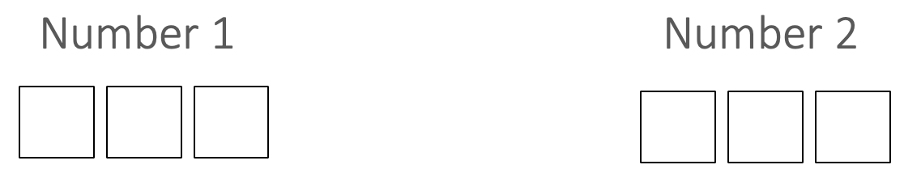
Biggest difference
(place value; subtraction as difference)
  A communal 10-sided dice is rolled.
  On each roll, players decide which place value slot to assign the number rolled.
  The players will keep rolling the dice until all place value slots are filled up.
  Whoever ends up with the biggest difference is the winner.

Slide 58
Principle 5.
Facilitates Home-School Connections
Biggest difference
(place value; subtraction as difference)

Slide 59
Reflecting on the games we looked at today
We played several games today that all had something in common.
What was it?
Examples
  Closest to X
  Choc-Chip Cookies
  Biggest Difference
  The King’s Tax
Non-Examples
  Caught Red-Handed
  Landgrab

Slide 60
Reflecting on the games we looked at today
We played several games today that all had something in common.
What was it?
Examples
  Closest to X
  Choc-Chip Cookies
  Biggest Difference
  The King’s Tax
Non-Examples
  Caught Red-Handed
  Landgrab
Communal Action
→
Individual Decision

Slide 61
Reflecting on the games we looked at today
We played several games today that all had something in common.
What was it?
Examples
  Closest to X
  Choc-Chip Cookies
  Biggest Difference
  The King’s Tax
Non-Examples
  Caught Red-Handed
  Landgrab
Roll and Allocate

Slide 62
Reflecting on the games we looked at today
We played several games today that all had something in common.
What was it?
Examples
  Closest to X
  Choc-Chip Cookies
  Biggest Difference
  The King’s Tax
Non-Examples
  Caught Red-Handed
  Landgrab
Roll and Allocate
Mathematically Integrated Games
  Strategic Agency
  Embedded Representation
  Reflection and Recording

Slide 63
Five principles of educationally-rich mathematical games

Slide 64
Educationally-rich mathematical games
James Russo
james.russo@monash.edu
www.surfmaths.com/games

Slide 65
References
Bragg, L. A. (2012a). The effect of mathematical games on on-task behaviours in the primary classroom. Mathematics education research journal, 24, 385-401.
Bragg, L. A. (2012b). Testing the effectiveness of mathematical games as a pedagogical tool for children’s learning. International journal of science and mathematics education, 10, 1445-1467.
Kullberg, A., Ingerman, Å., & Marton, F. (2024). Planning and analyzing teaching: Using the variation theory of learning. Taylor & Francis
Nurnberger-Haag, J., Wernet, J. L., & Benjamin, J. I. (2023). Gameplay in Perspective: Applications of a Conceptual Framework to Analyze Features of Mathematics Classroom Games in Consideration of Students' Experiences. International Journal of Education in Mathematics, Science and Technology, 11(1), 267-303.
Russo, J., Bragg, L. A., & Russo, T. (2021). How Primary Teachers Use Games to Support Their Teaching of Mathematics. International Electronic Journal of Elementary Education, 13(4), 407-419.
Russo, J., & Russo, T. (2020). Transforming mathematical games into investigations. Australian Primary Mathematics Classroom, 25(2), 14-19.
Russo, J., Russo, T., & Bragg, L. (2021). Why that game?: Factors primary school teachers consider when selecting which games to play in their mathematics classrooms. In Y. H. Leong, B. Kaur, B. H. Choy, J. B. W. Yeo, & L. F. Wong (Eds.), Excellence in Mathematics Education: Foundations and Pathways (Proceedings of the 43rd annual conference of the Mathematics Education Research Group of Australasia) Singapore: MERGA.
Russo, J., Russo, T., & Bragg, L. A. (2018). Five principles of educationally rich mathematical games. Australian Primary Mathematics Classroom, 23(3), 30-34.

